Slide 1
Experience API Data Reporting
Steven Vergenz and Mick Muzac
Contractors with AQuate Corp. in support of the ADL Initiative
I/ITSEC Plugfest
3 December 2014
Orlando, FL

Slide 2
The Basics
Each meaningful interaction between the Learner and Content is logged via xAPI calls
Interaction statements take form “I did this”
Logged via simple REST API
Any internet-enabled device can participate
Enables big-data analytics on learner data

Slide 3
xAPI in 30 seconds
Each meaningful interaction between the Learner and Content is logged via xAPI calls
Interaction statements take form “I did this”
Logged via simple REST API
Any internet-enabled device can participate
Enables big-data analytics on learner data

Slide 4
Why Bother?
It can track everything SCORM does
Quiz answers, course progress, etc.
Also tracks things that SCORM can't
Simulations, native apps, live experiences, etc.
Opens up learner records, prevents lock-in
Non-LMS systems can view/publish records

Slide 5
Sample Statement
{
"actor": {
"mbox": "mailto:gia.creech@myschool.edu",
"name": "Gia Creech" },
"verb": {
"id": "http://adlnet.gov/expapi/verbs/answered",
"display": { "en-US": "answered" } },
"object": {
"definition": { "name": "final/q49" },
"id": "http://myschool.edu/xapi/cop-3223/final/q49" },
"result": { "success": false },
"context": { "contextActivities": { "parent": [ {
"id": "http://myschool.edu/xapi/cop-3223/final"
} ] } }
}

Slide 6
xAPI Dashboard?
It can track everything SCORM does
Quiz answers, course progress, etc.
Also tracks things that SCORM can't
Simulations, native apps, live experiences, etc.
Opens up learner records, prevents lock-in
Non-LMS systems can view/publish records

Slide 7
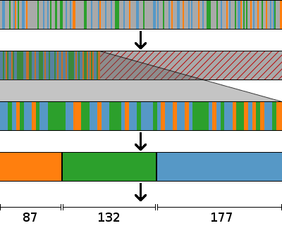
Processing xAPI Statements
Raw xAPI statements
Separate relevant statements from irrelevant
Throw out irrelevant statements
Gather like statements into groups
Aggregate each group into a single meaningful value

Slide 8

Contact Us
Steven Vergenz
Mick Muzac
Contractors with AQuate Corp.
Supporting the ADL Initiative
steve.vergenz.ctr@adlnet.gov
mick.muzac.ctr@adlnet.gov

